Slide 1
FastX Bus
Ticket Booking
By Team 10 - Roshan and Rohan
Mentor - MOHD. JAVEED SIR

Slide 2
TABLE OF CONTENTS
01
04
Problem Statement & Technology Used
Bus Operator Functionalities
02
05
Roles
User Functionalities
03
06
Admin Functionalities
System Functionalities & Application Flow

Slide 3
Problem Statement & Technology Used
PROBLEM STATEMENT: The FASTX online BUS TICKET BOOKING SYSTEM is a web based application that allows user to search for bus routes and book tickets online. It connects passengers with bus operators, simplifying the process of, planning journeys, and managing bookings.
Technologies Used:
Frontend: Angular Js.
Backend: Java, Spring Boot.
Database: MySql.
Authentication: JSON Web Tokens (JWT) for secure user authentication.
:

Slide 4
Roles
Admin
Bus Operator
User
System

Slide 5
Admin Functionalities
Log In
Add Buses
Display all admins and all users details
Display all buses and all bus operator details
Can Update Admin Profile
Logout

Slide 6
Bus Operator Functionalities
Log In as Bus Operator
Can fetch/delete Bus Details
Update Bus details and Bus Operator details
Logout

Slide 7
User Functionalities
User Registration / SignUp
User Login.
Search Bus by Routes
Book Bus
View Booking Details
Edit Profile

Slide 8
System Functionalities
Authenticate User
Store Bus routes .
Store Booking Information.
Store User and Bus Operator Information.

Slide 9
Flow of Application
At First, we will open the application which will redirect us to the home page.
Then in home page we will get an option to Search Bus by routes.
Also we will get an option to sign up as user and login as Admin, Bus Operator or Passenger.
After login as admin we can Add Bus, Display all admins and all users details,Display all buses and all bus operator details also we can Update Admin Profile.
After signup or login as user we can Search Bus by Routes, Book bus, view booking details also can edit user profile.
After login as bus operator we can Can fetch/delete Bus Details, also can Update Bus details and Bus Operator details.

Slide 10
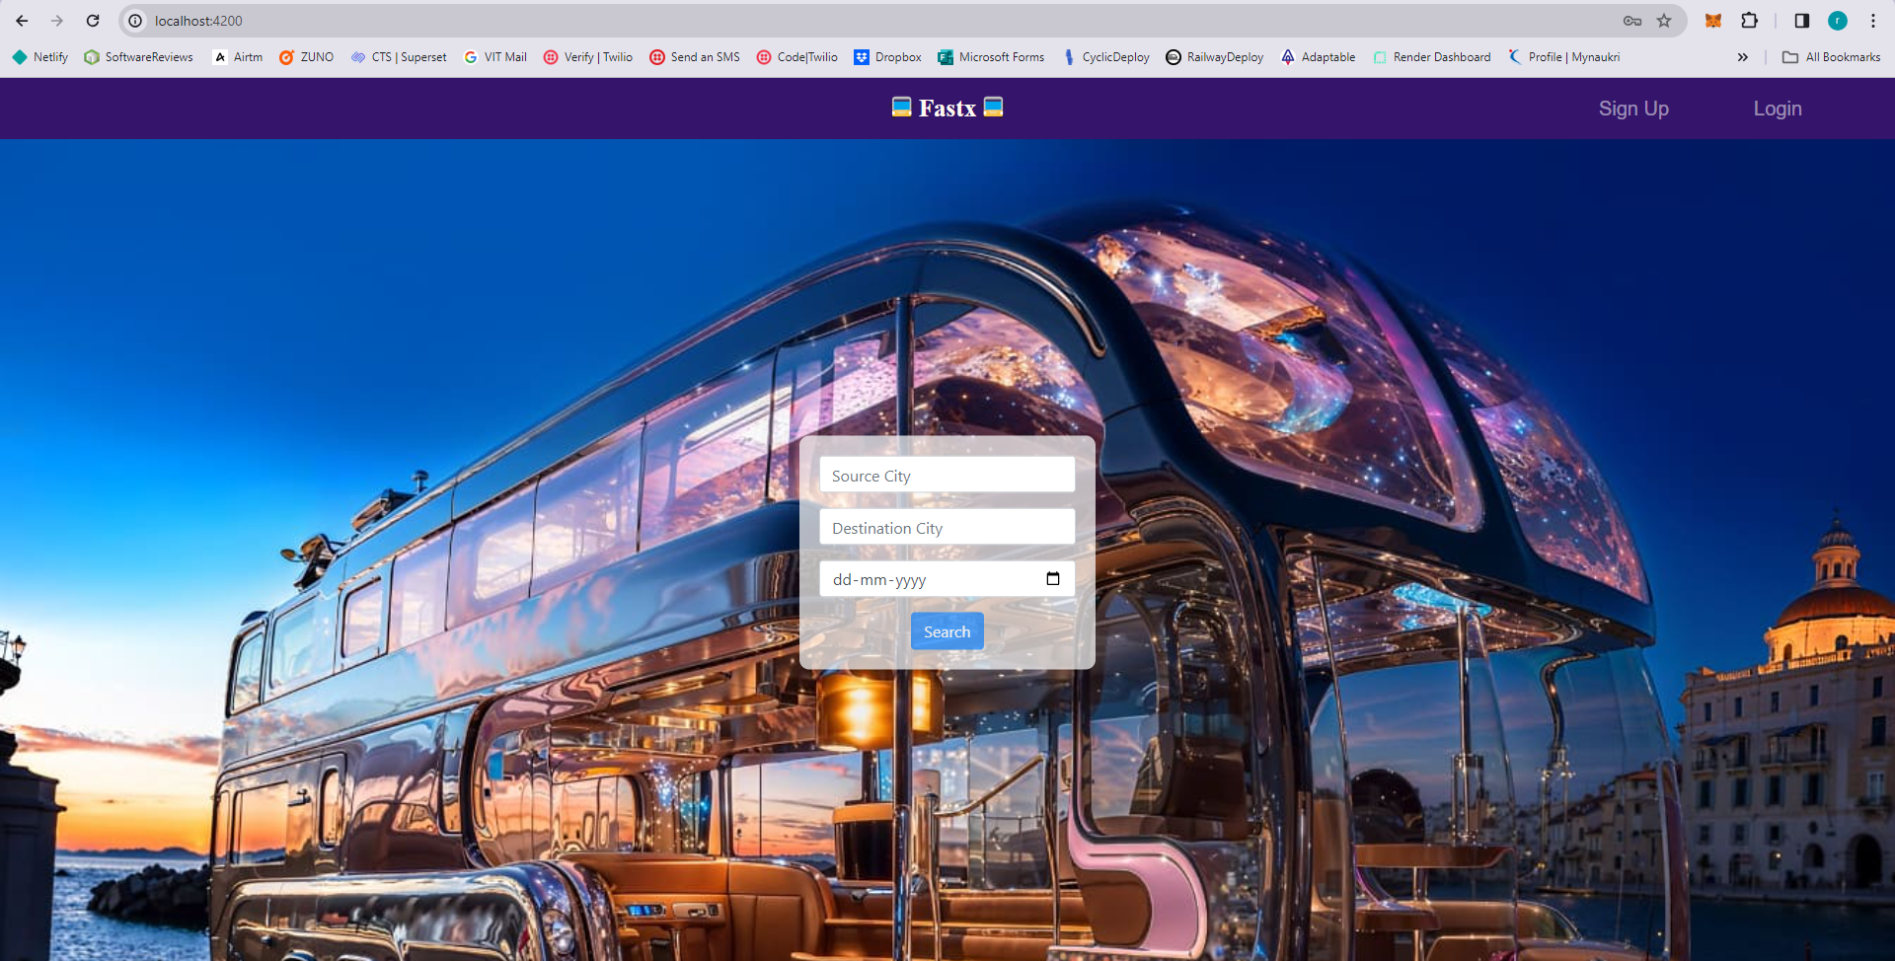
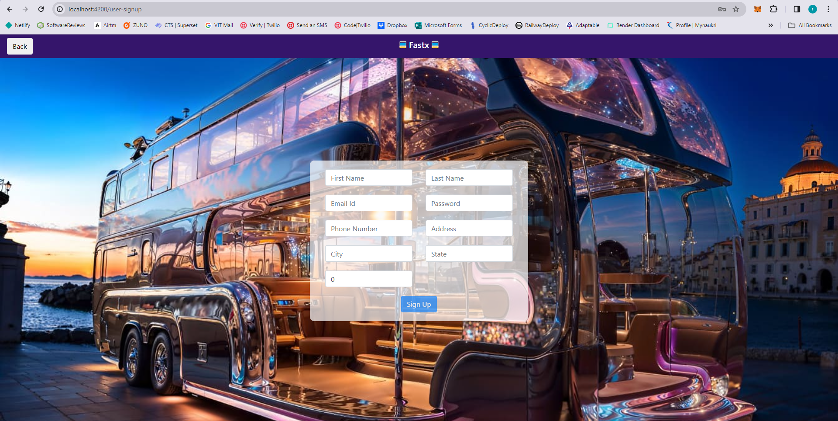
Screenshots

Slide 11
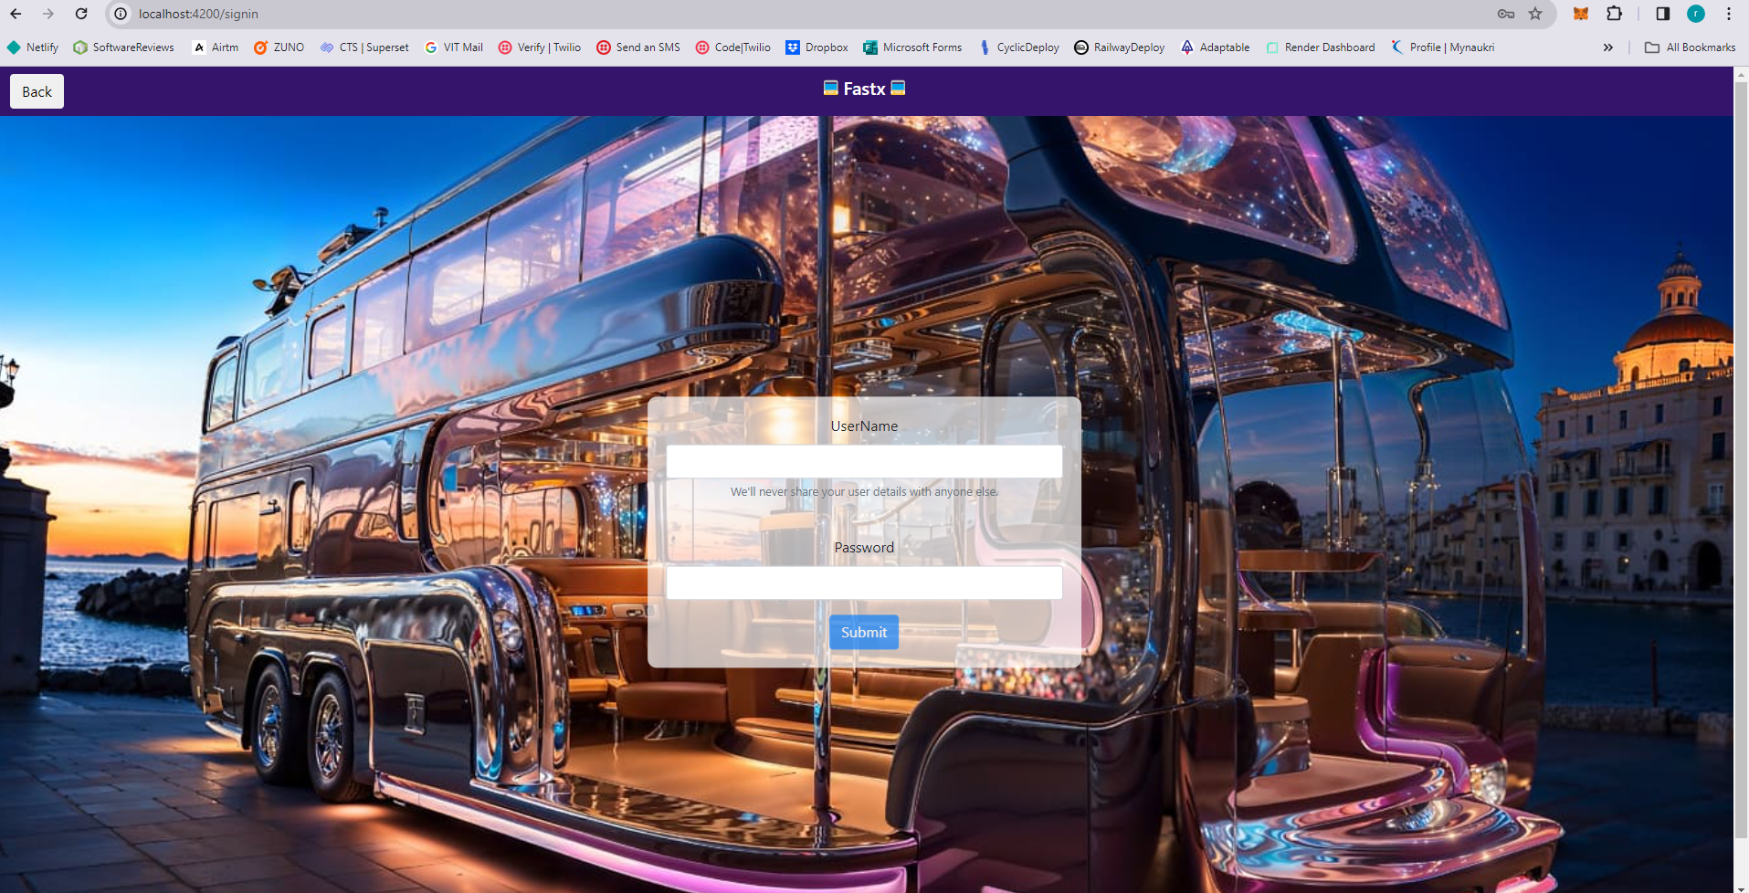
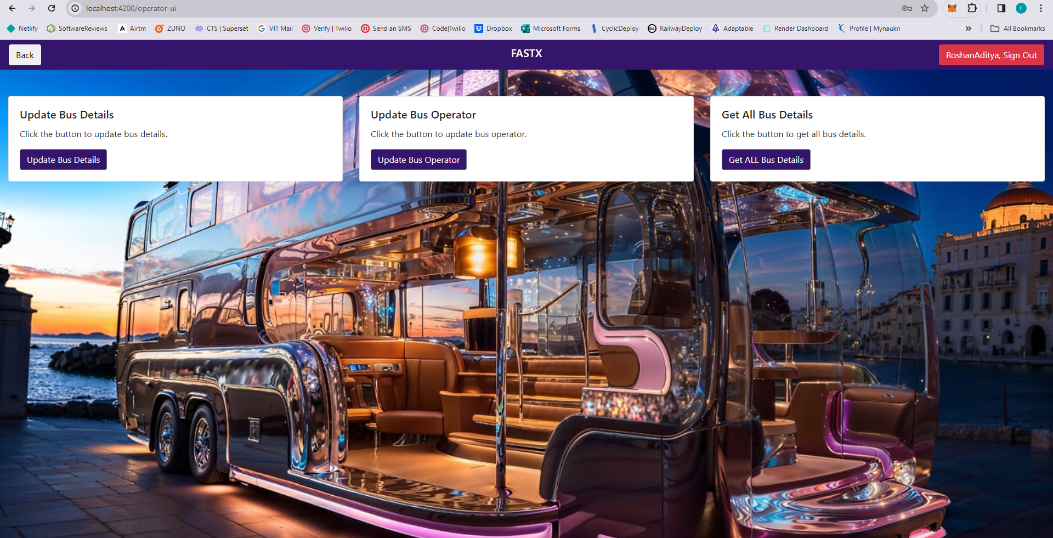
Screenshots

Slide 12
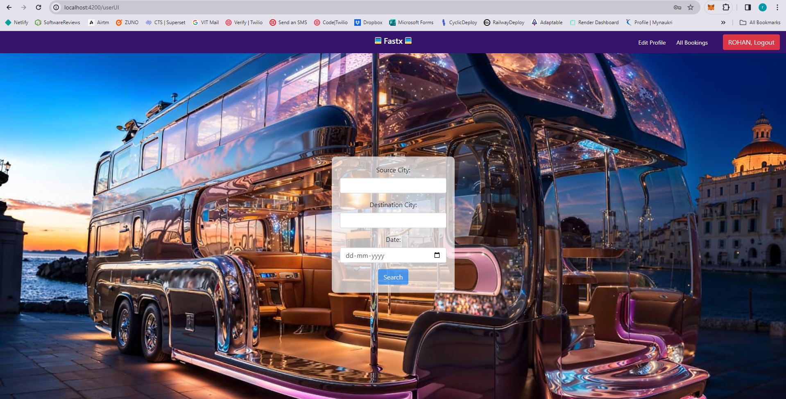
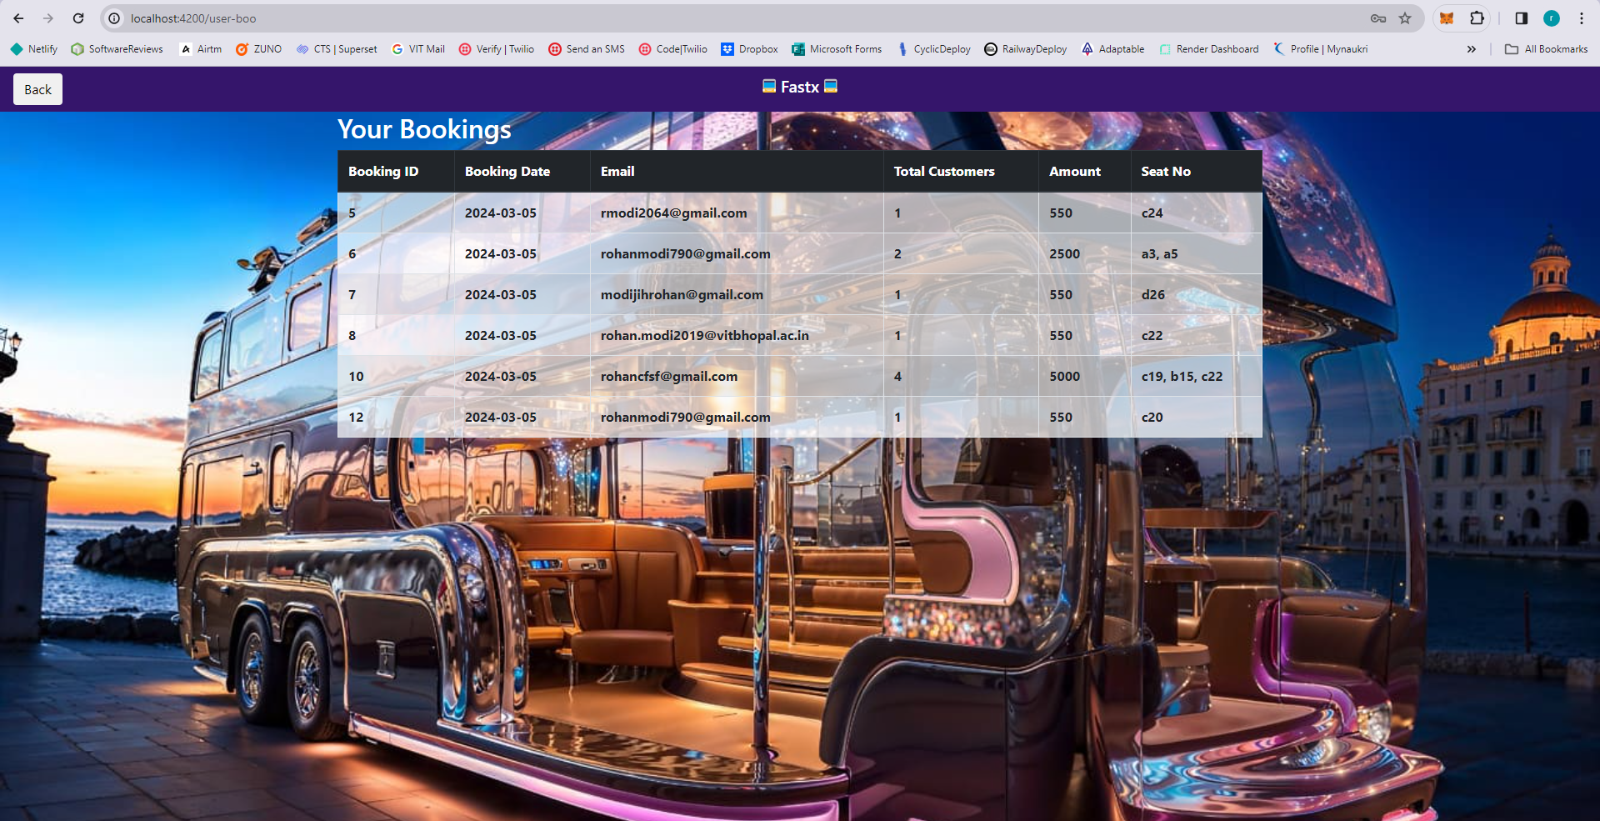
Screenshots

Slide 13
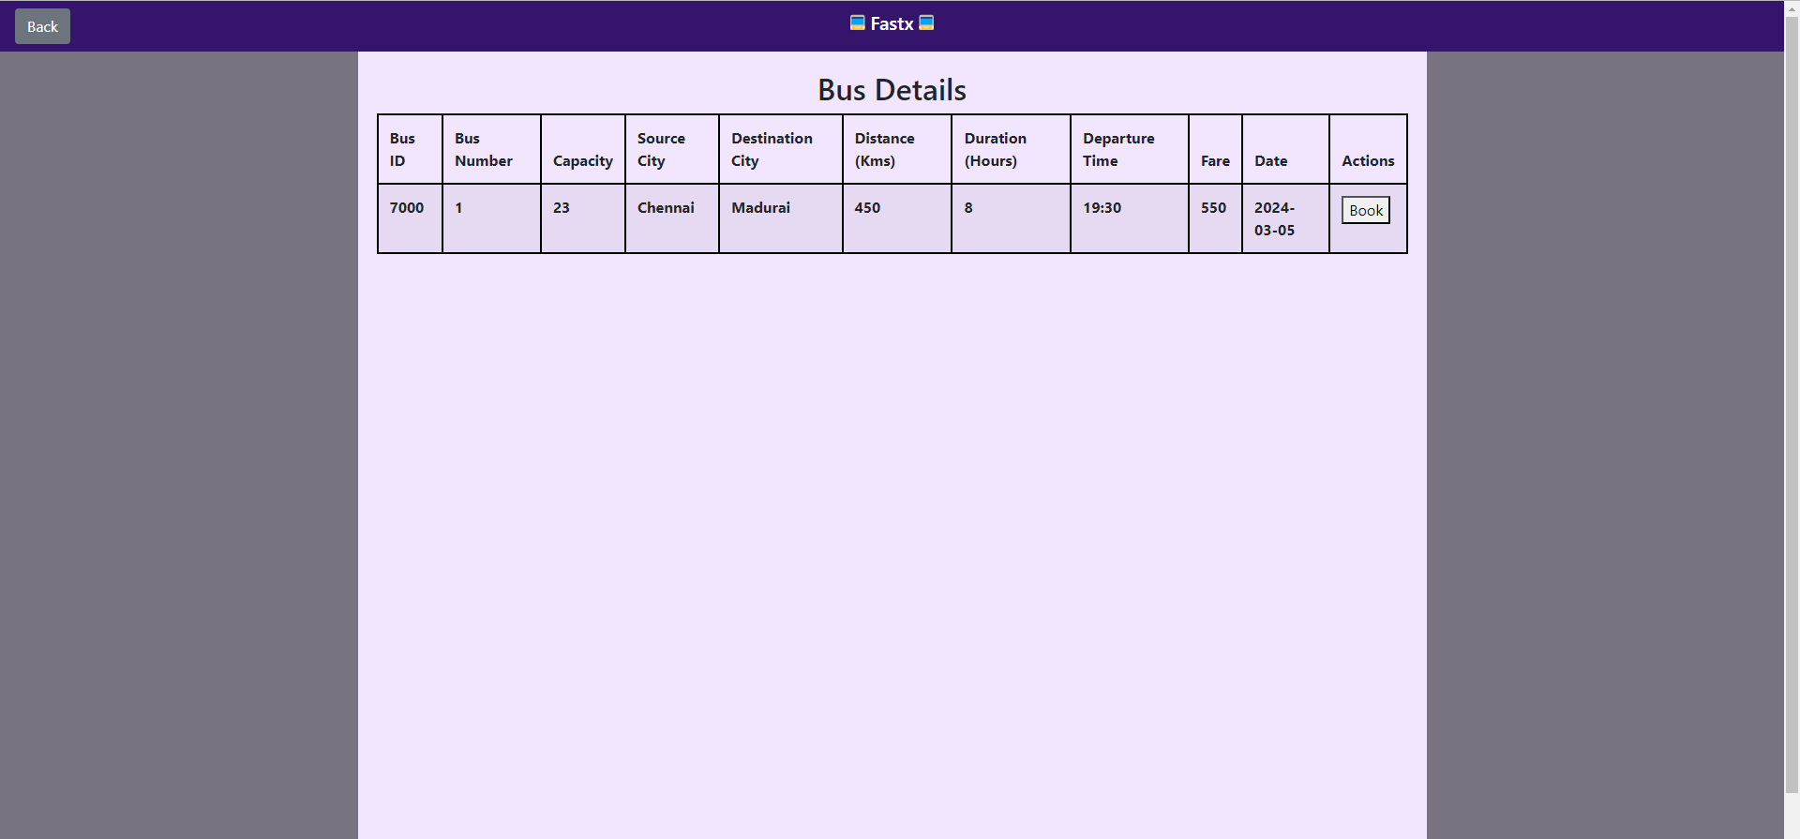
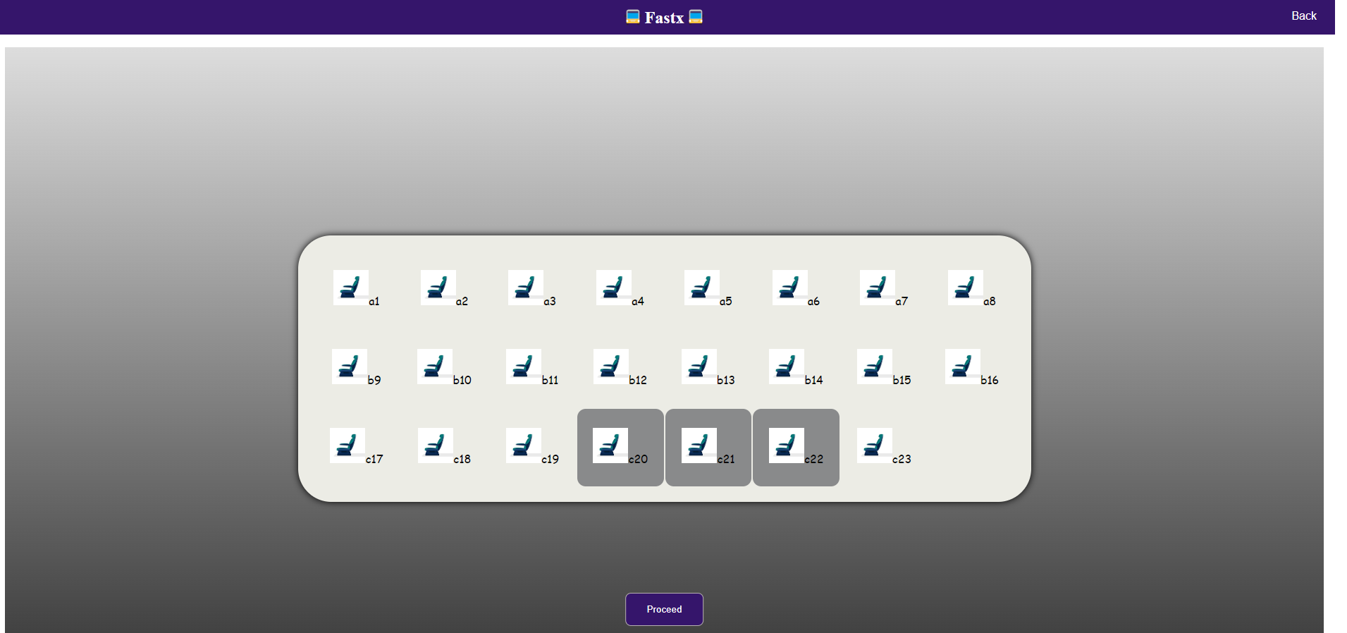
Screenshots

Slide 14
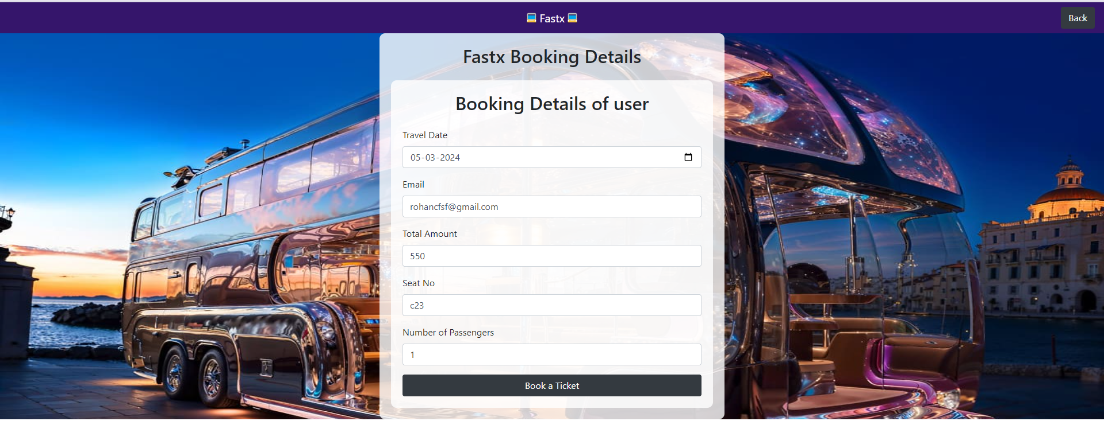
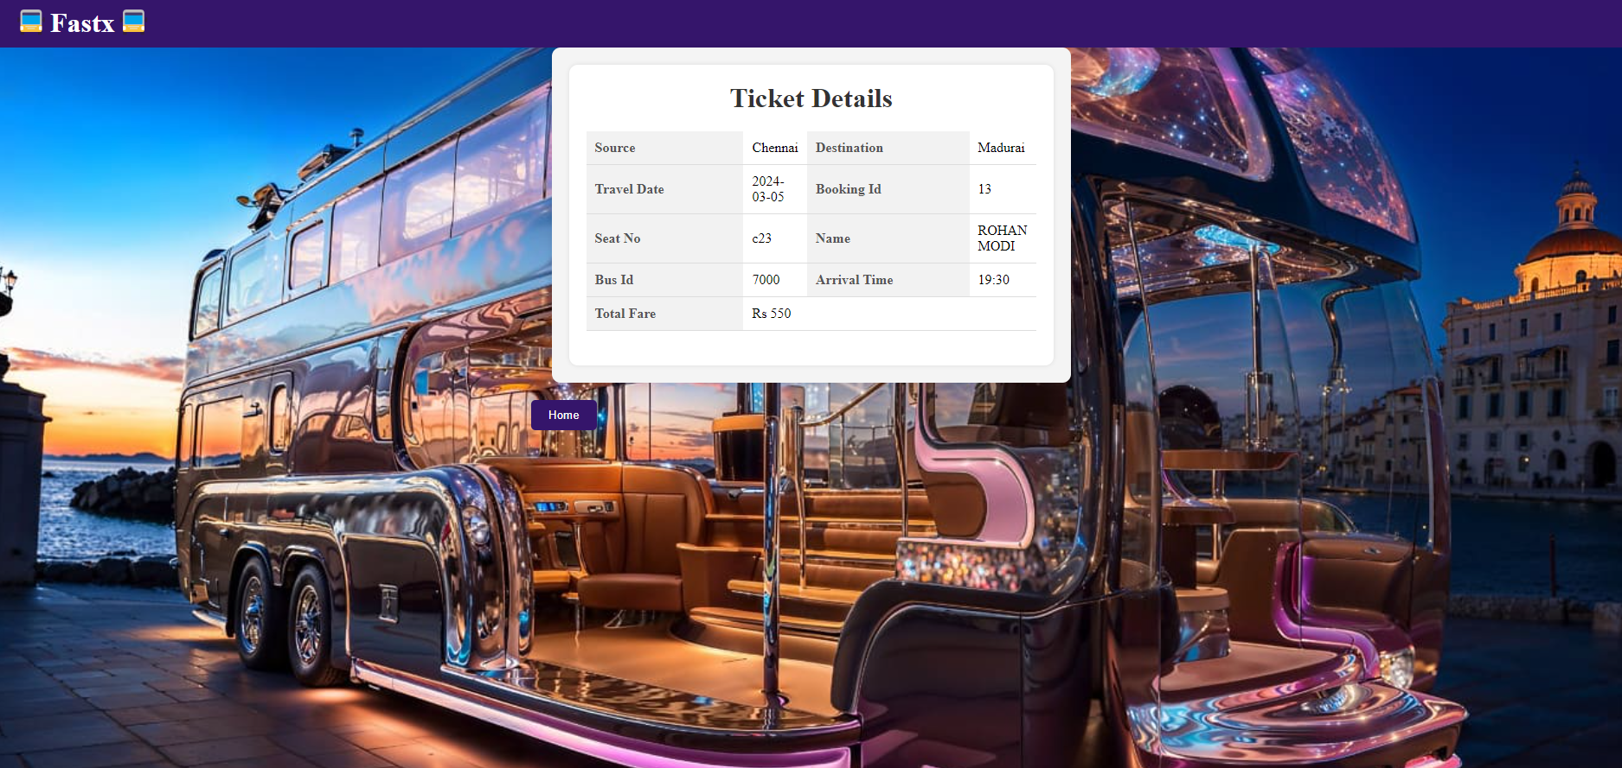
Screenshots

Slide 15
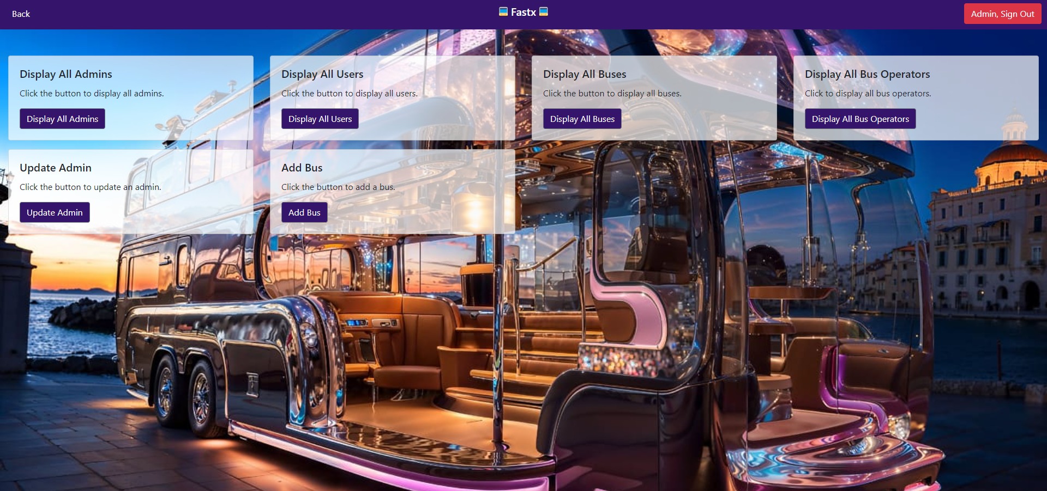
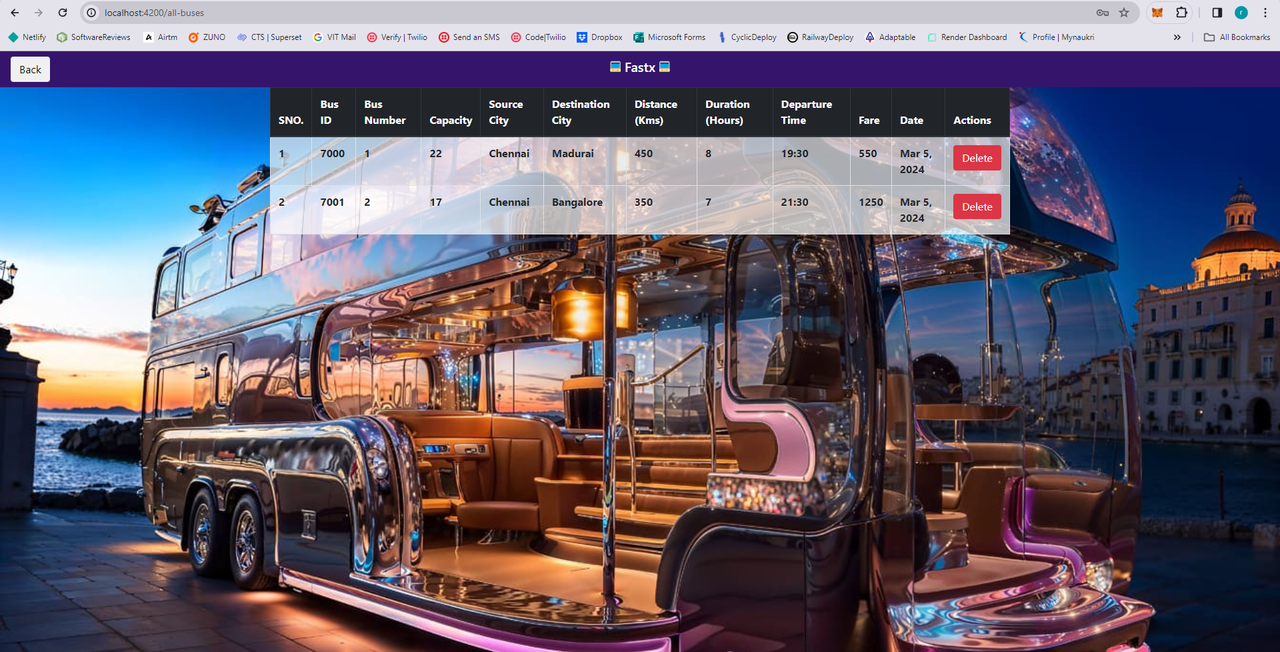
Screenshots

Slide 16
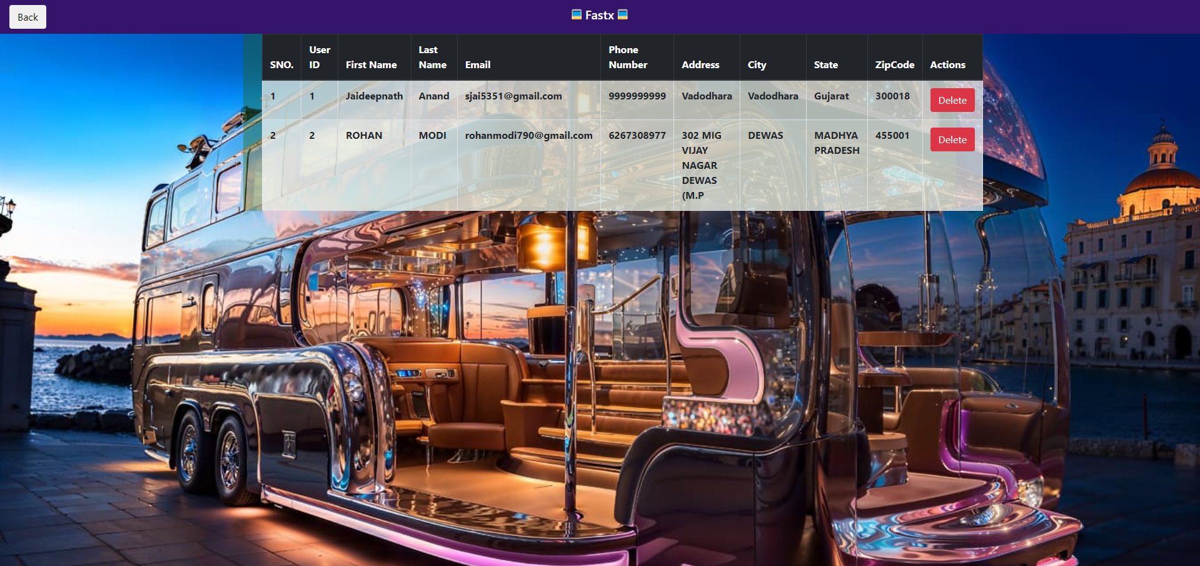
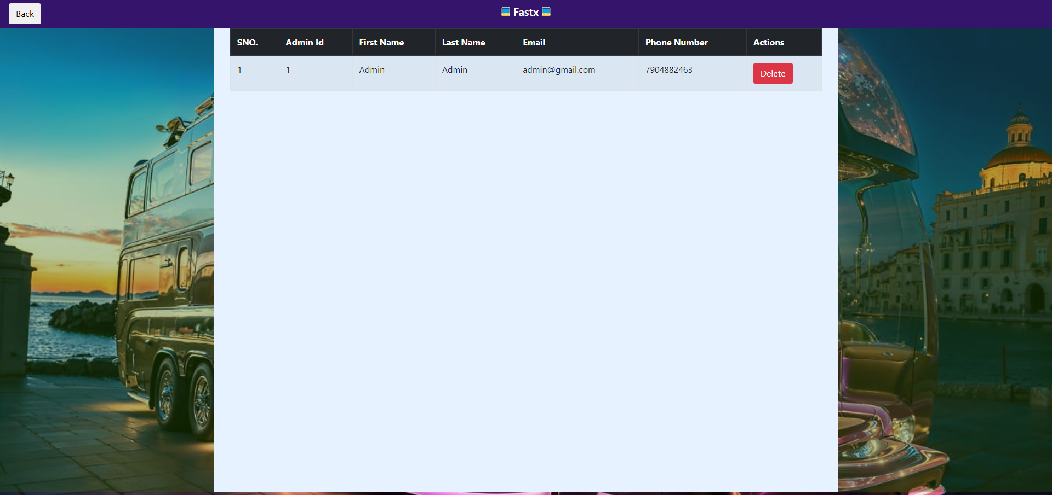
Screenshots

Slide 17
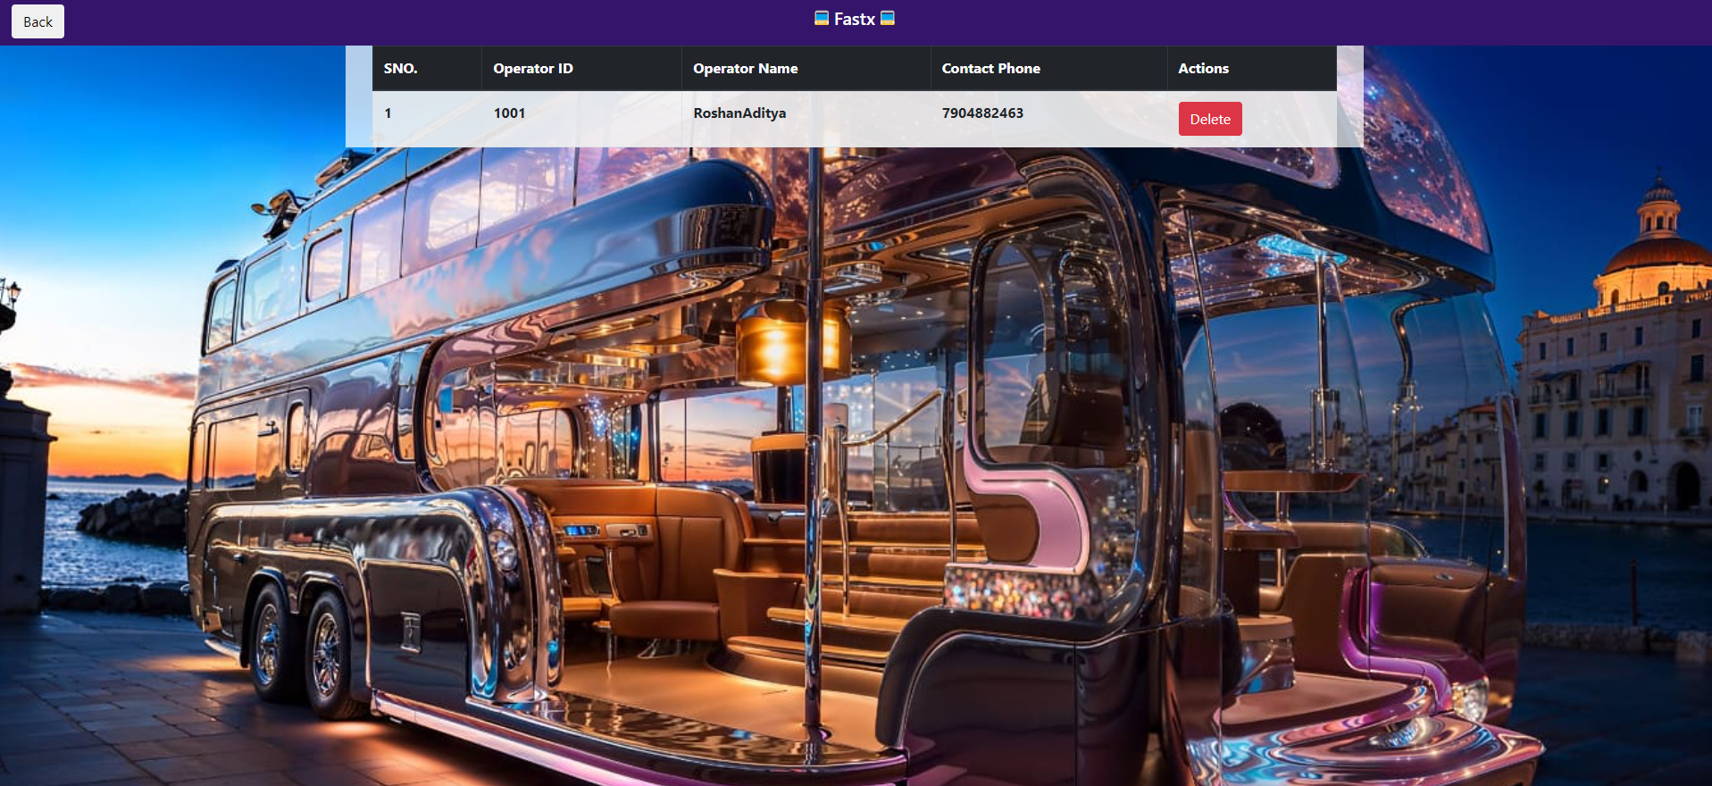
Screenshots

Slide 18
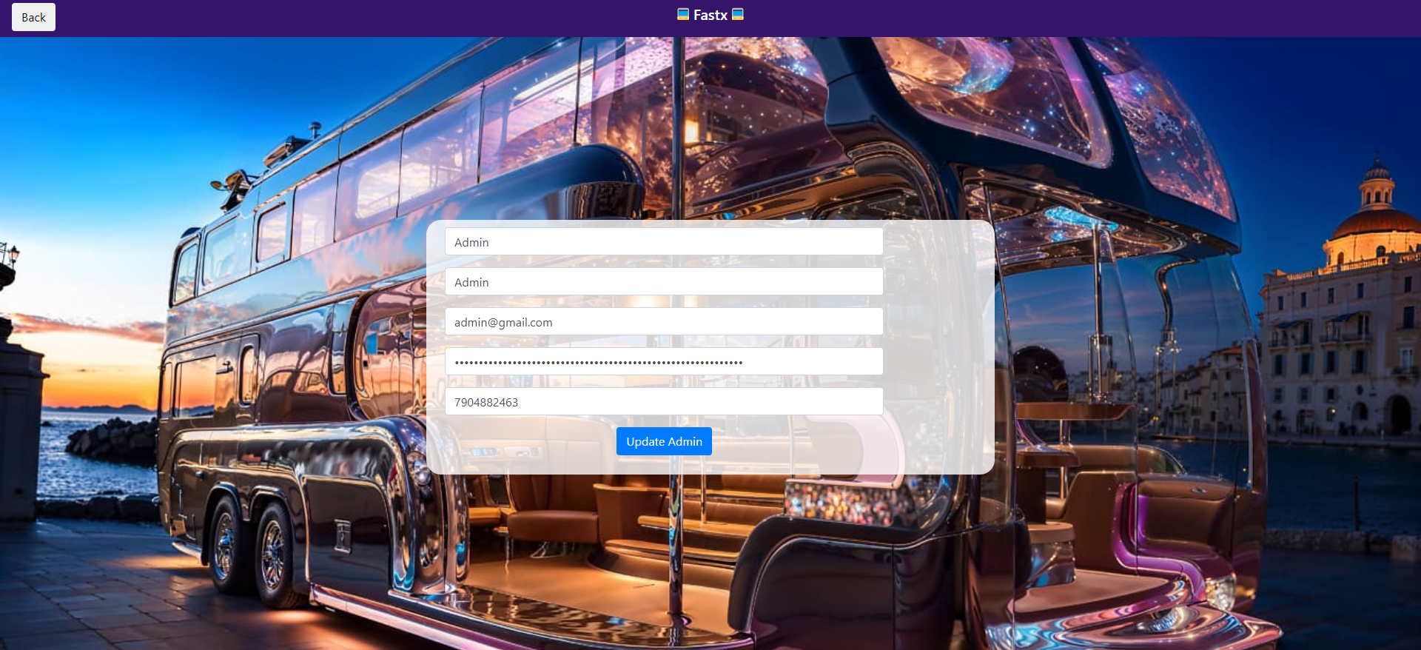
Screenshots

Slide 19
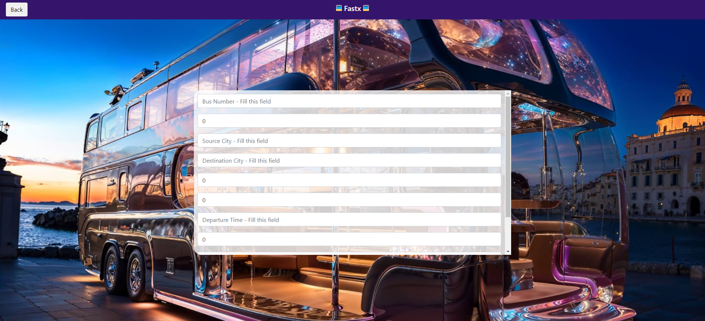
Screenshots

Slide 20
THE TEAM
ROSHAN ADITYA M
ROHAN MODI

Slide 21
THANKS!

